Slide 1
MAIL_ORDER
20144842 임현택
20154330 박은빈

Slide 2
Using Language
Program Language : Java
SQL Language : MySQL

Slide 3
CONTENTS
01
02
03
04
ER Diagram
Tables & Layout
Demo Video
Q & A

Slide 4
01
ER Diagram

Slide 5
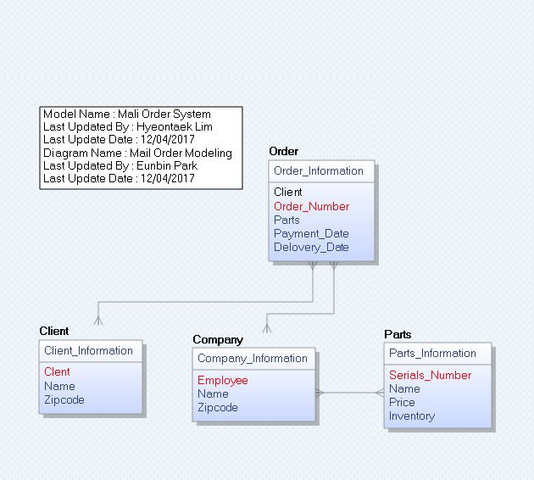

01.
ER Diagram
ERDiagram
using ERWin

Slide 6
02
Description Tables

Slide 7
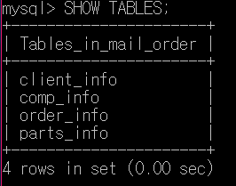
MailOrder

Slide 8
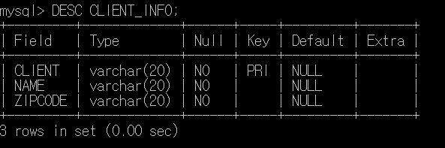
Client Information

Slide 9
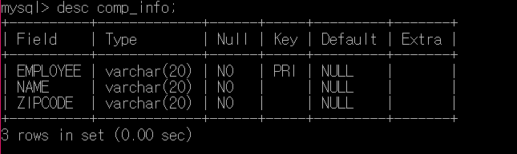
Company Information

Slide 10
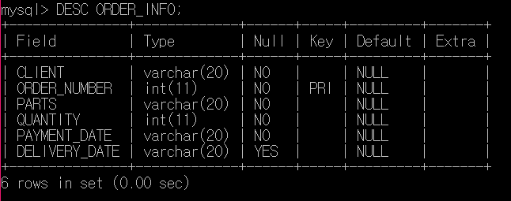
Order Information

Slide 11
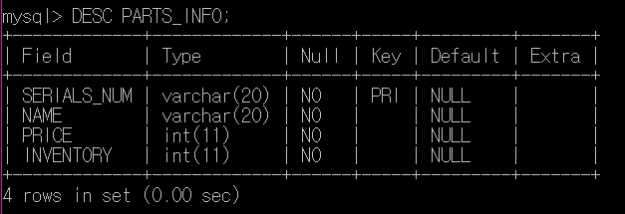
Parts Information

Slide 12
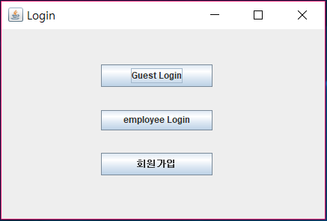
Login Layout

Slide 13
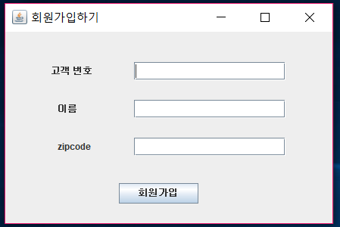
Member Join Layout

Slide 14
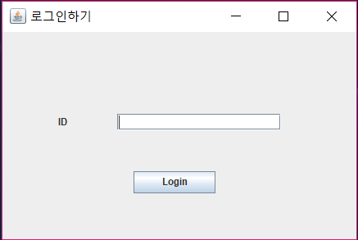
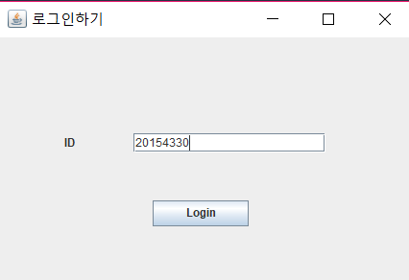
Client Login Layout

Slide 15
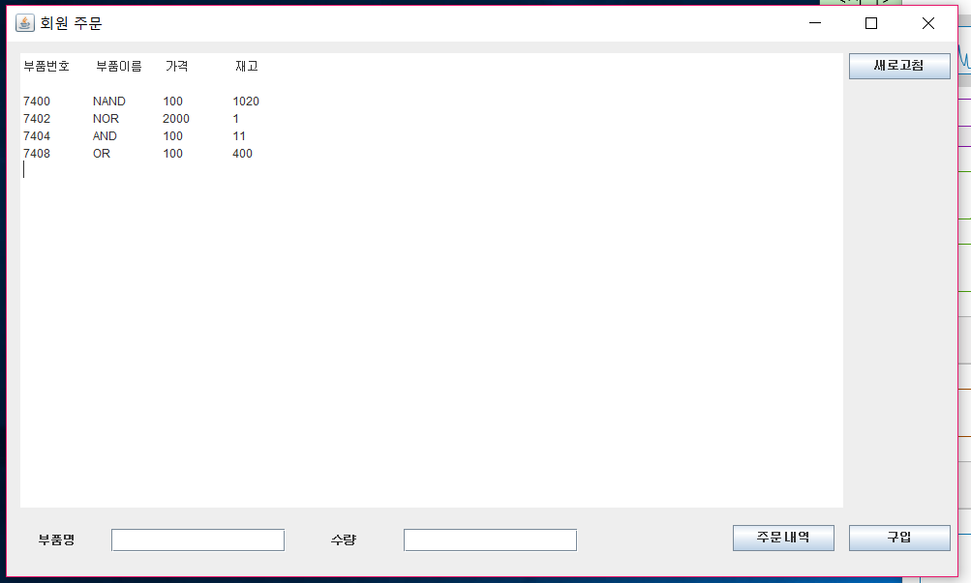
Client Order Layout

Slide 16

Client Order Layout

Slide 17
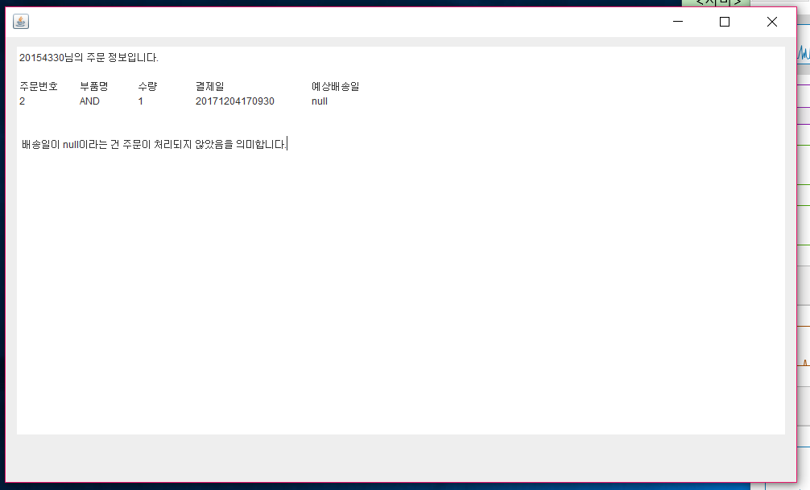
Client Order Layout

Slide 18
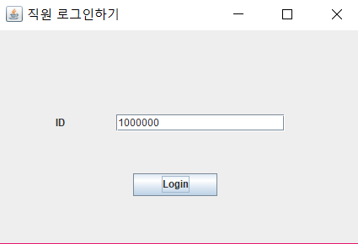
Employee Login Layout
화면

Slide 19
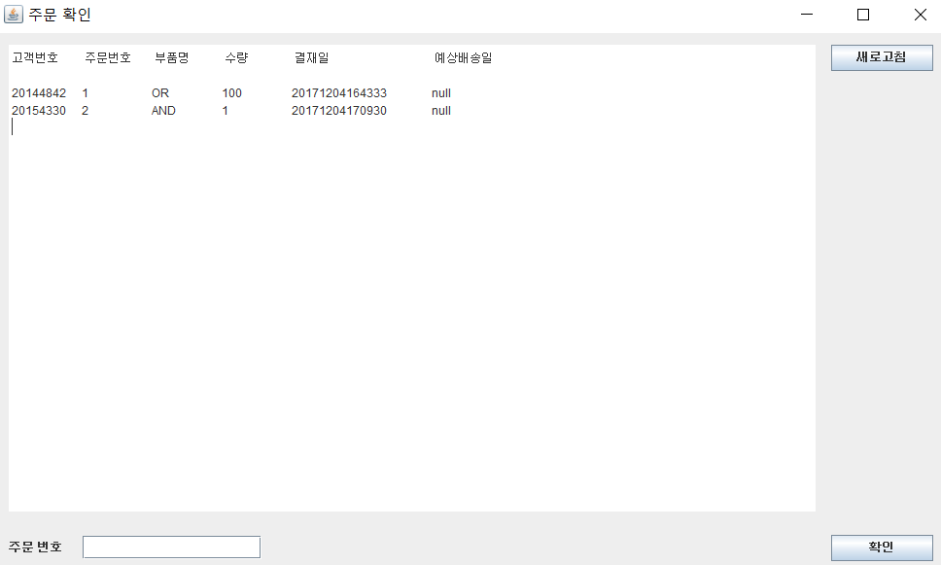
Order List Confirm Layout

Slide 20
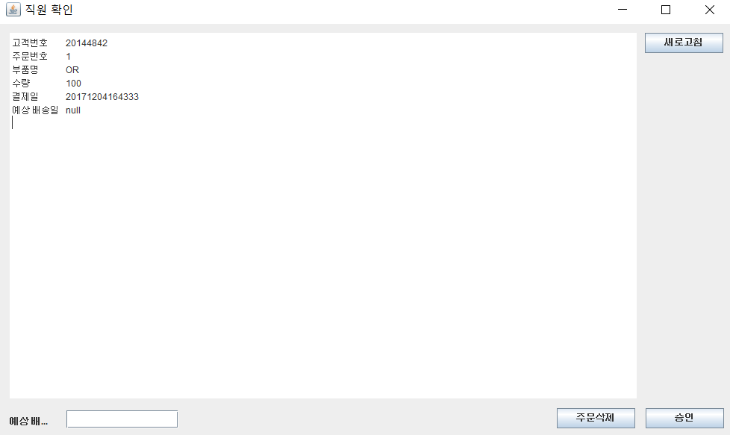
Order Revise Layout(Employee)

Slide 21
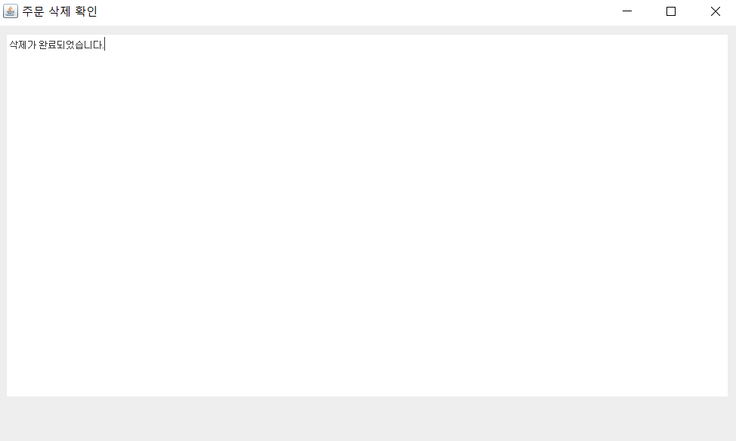
Delete Order Layout

Slide 22
03
Demo Video

Slide 23
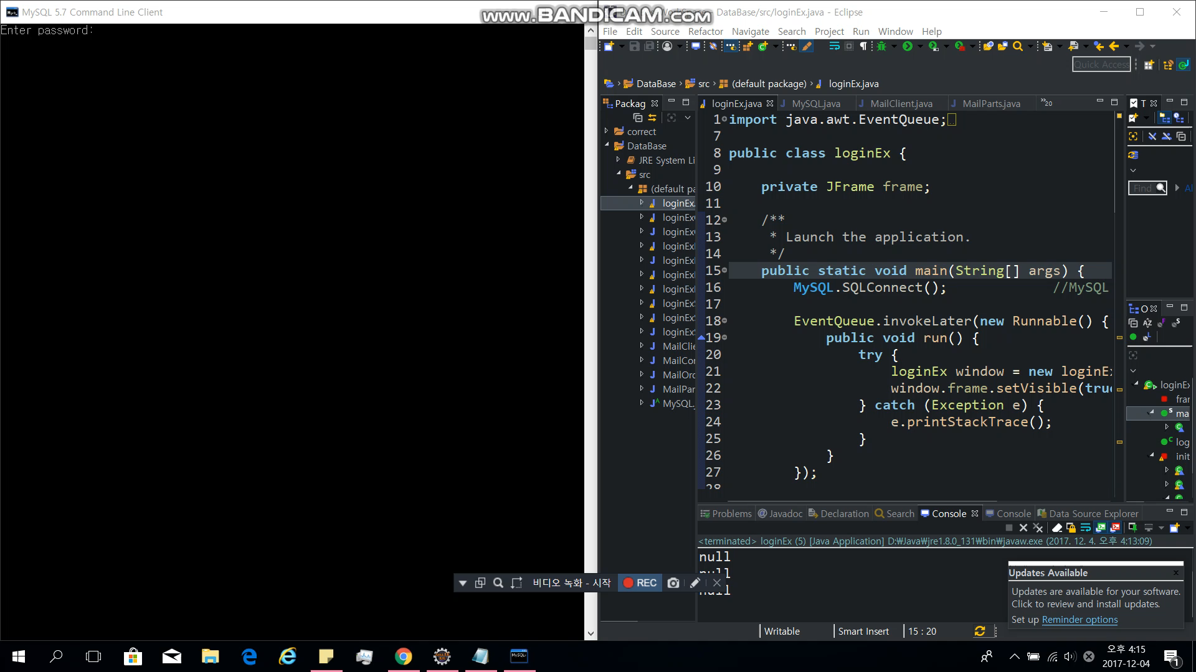
Demo Video

Slide 24
04
Q&A

Slide 25
Thank you

